Slide 1
Foundation of Computer Science
Lecture 6
Rules of Inference with Quantifiers
Resolution Principle

Slide 2
Rules of Inference with Quantifiers
Universal Instantiation
premises: ∀x P(x)
conclusion: P(c), for any c
Example: Our domain consists of all dog & Fido is a dog
“All dogs are cuddly”
“Therefore , Fido is cuddly”

Slide 3
Rules of Inference with Quantifiers
Universal Generalization
premises: P(c), for any c
conclusion: ∀x P(x)

Slide 4
Rules of Inference with Quantifiers
3. Existential Instantiation
premises: conclusion:
∃ x P(x)
P(c), for some element c
Example:
“ There is someone who got an “A” in the course.
“Lets call her ‘x’ and say ‘x’ got an ‘A’

Slide 5
Rules of Inference with Quantifiers
4. Existential Generalization
P(c) for some element c
∃ x P(x )
premises: conclusion:
Example:
“Renu got ‘A’ in the class
Therefore, someone got ‘A’ in the class

Slide 6
Applying Rules of Inferences
Example 1: It is known that
A student in this class has not read the book.
Everyone in this class passed the first exam.
Can you conclude that “Someone who passed the first exam has not read the book”?

Slide 7
Solution
To simplify the discussion, let
C(x ) | := | x is a student in the class
B(x ) | := | x has read the book
P(x) | := | x passed the first exam
We will give a valid argument with premises: ∃x ( C(x) ∧ ¬B(x ) ),
∀x ( C(x) → P(x ) )
conclusion: ∃x ( P(x) ∧ ¬ B(x ) )

Slide 8
Solution
Step
1. ∃x ( C(x) ∧ ¬B(x ) )
2. C(a) ∧ ¬B(a)
3. C(a)
4. ∀x ( C(x) → P(x ) )
5. C(a) → P(a)
6. P(a) 7. ¬B(a)
8. P(a) ∧ ¬B(a)
9. ∃x ( P(x) ∧ ¬ B(x ) )
Reason
Premise
Existential Instantiation Simplification by (2) Premise
Universal Instantiation Modus Ponens by (3) and (5)
Simplification by (2)
Conjunction by (6) and (7) Existential Generalization

Slide 9
Solve the question
Using the rules of inference, construct a valid argument to show that
“John Smith has two legs” is a consequence of the premises:
“Every man has two legs.”
“John Smith is a man.”

Slide 10
Resolution Principal
Another way to prove the validity of arguments is using resolution principle
The rule of inference called resolution is based on the tautology:
((p Vq) ^ (¬ p V r)) → (qVr)
If we express the hypotheses and the conclusion as clauses (possible by CNF, a conjunction of clauses), we can use resolution as the only inference rule to build proofs!
This is used in programming languages like Prolog.
It can be used in automated theorem proving systems.

Slide 11
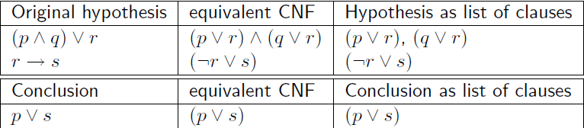
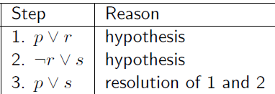
Proofs that use exclusively resolution as inference rule
Step 1 Convert hypotheses and conclusion into clauses:
Step 2 Write a proof based o resolution

Slide 12
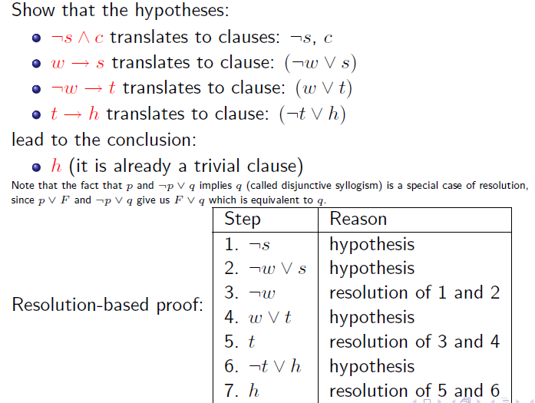

Slide 13
Solve the question using resolution
Show the following argument is valid
If today is Tuesday, I have a test in mathematics or Economics. If my Economics Professor is sick, I will not have test in economics. Today is Tuesday and my Economics Professor is sick . Therefore I have a test in Mathematics

Slide 14
Thank You

